Slide 1
BIOINFORMATICS
Beyond Graphical Networks: Extending Indexed Concatenation Notation to Protein Sequences
Sessie Research Team overseen by Dr. Caviness

Slide 2



NOTATION EXAMPLES
Concatenating Strings
ABCABCABC
$$\text{"ABC"}⧺"\text{ABC"}⧺"\text{ABC"}$$
There is no generally accepted binary operator for concatenation
$$\overset{3}{€}\text{"ABC}"$$
$$€$$

Slide 3

NOTATION EXAMPLES
Concatenating Numeric Digits
0.333333333333333333333333333333333333333333333333333333333333333333333333333333...
$$0.\overset{∞}{€}3$$

Slide 4









Where else can we apply this?
AUG ACG GAG CUU CGG AGC UAG
AUG ACG GAG CUU CGG AGC UAG
Notes:
TRANSLATION

Slide 5
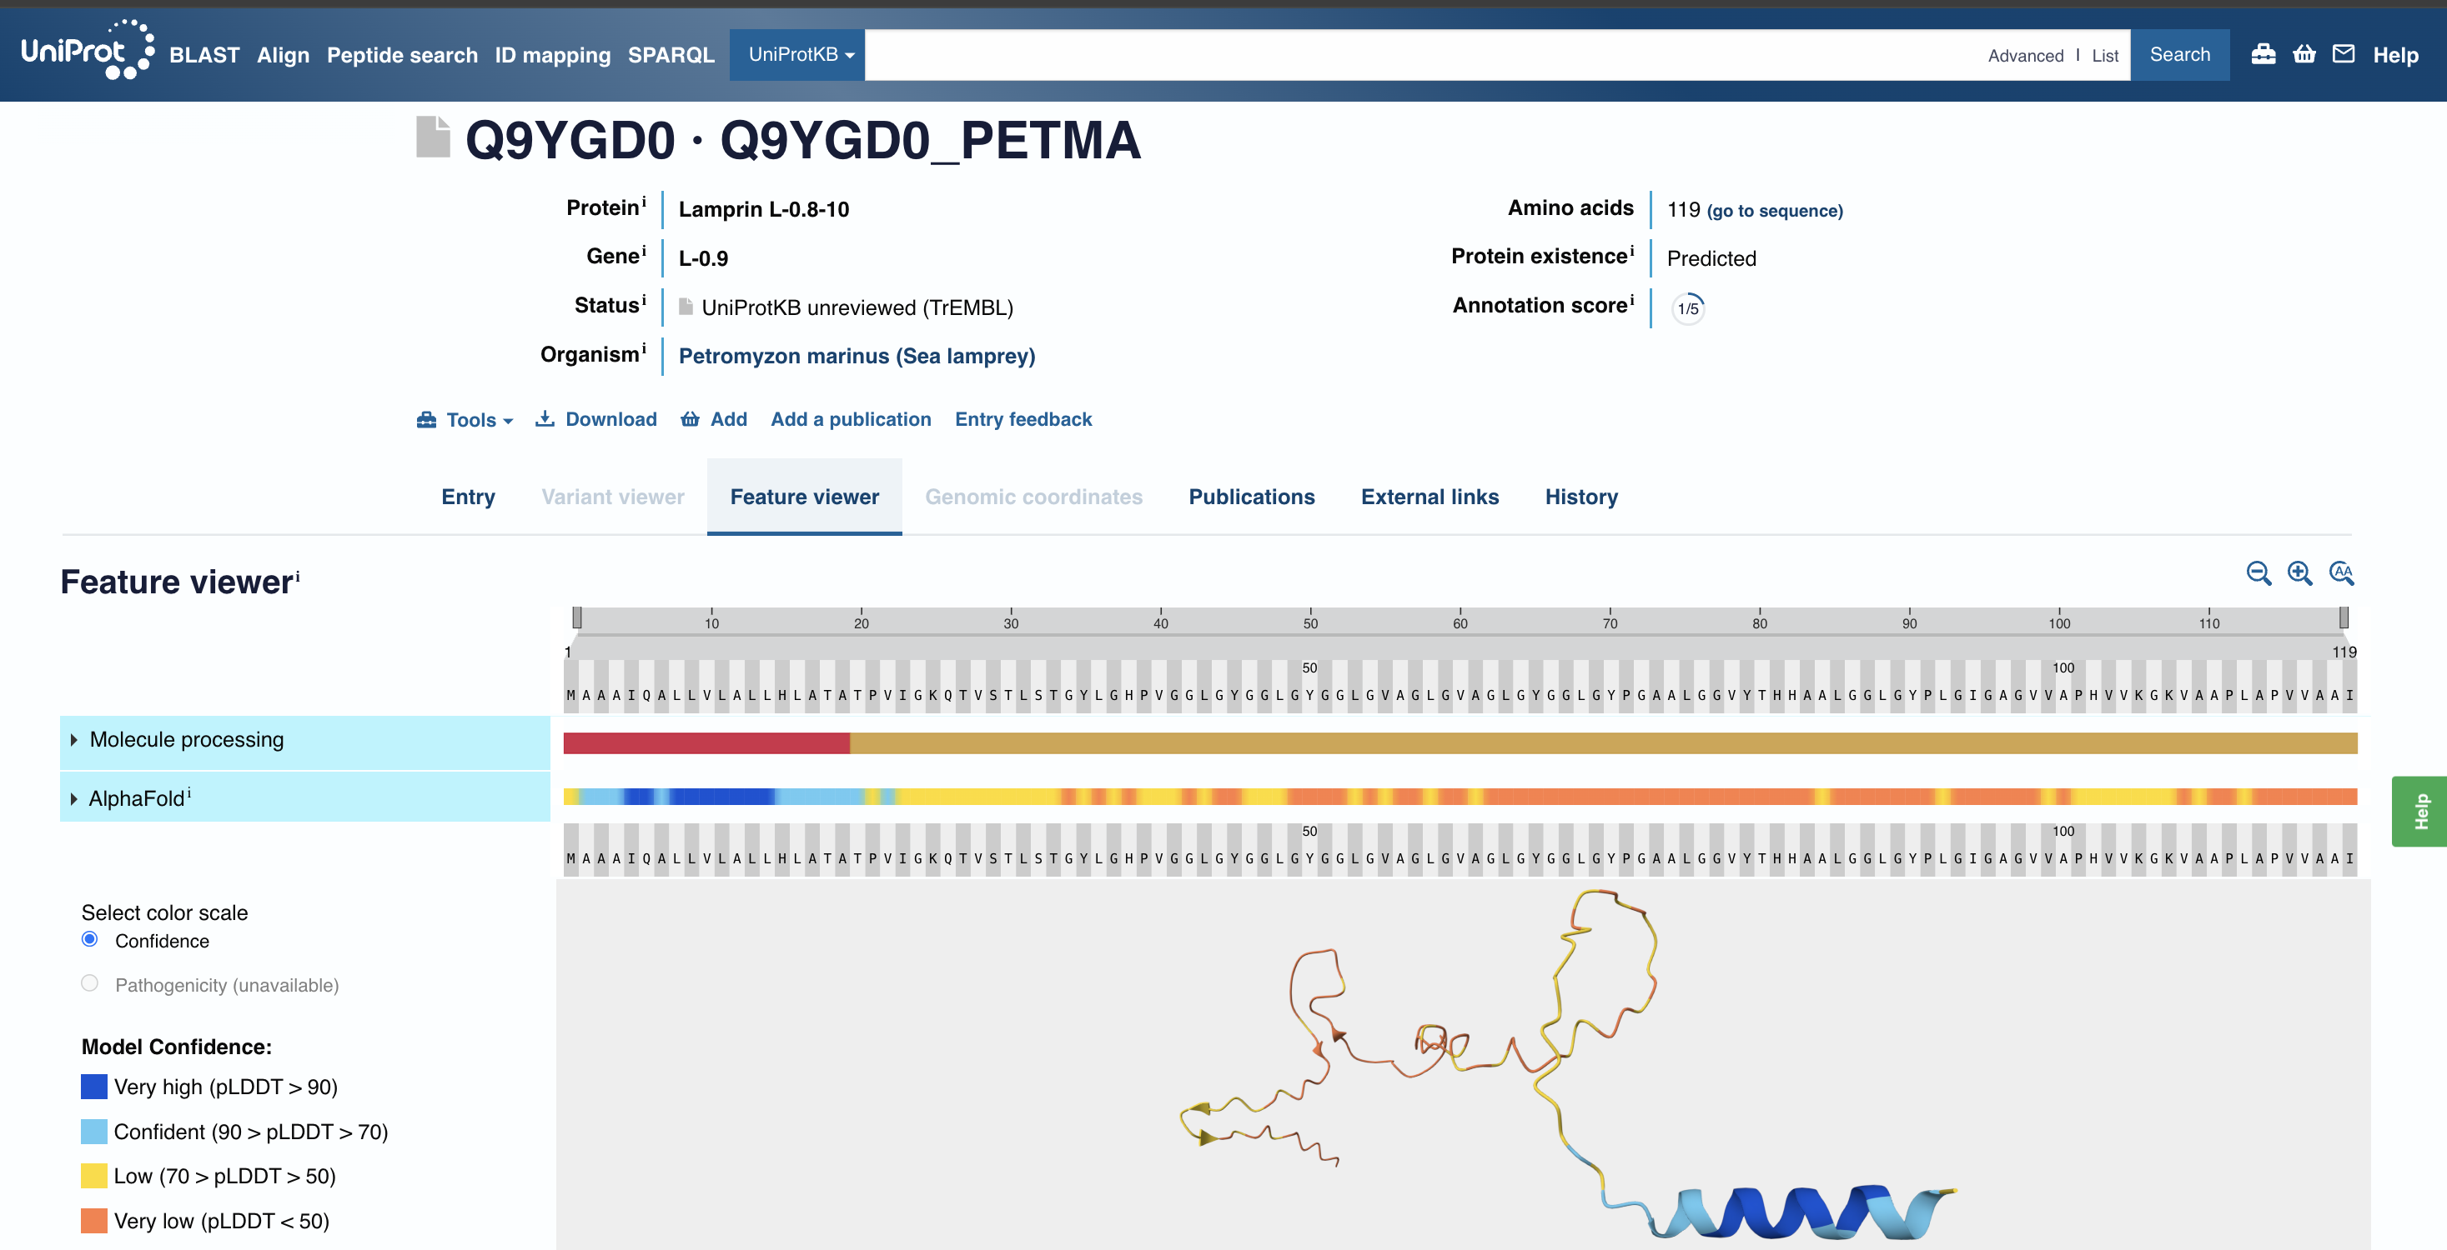
Notes:
BLAST (BASIC LOCAL ALIGNMENT SEARCH TOOL) bioinformatics algorithm that compares sequences with a large database of known biological sequences

Slide 6
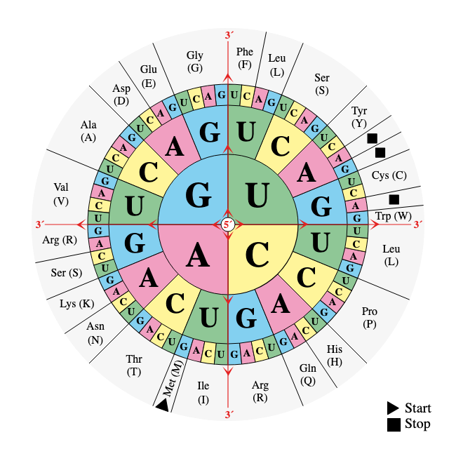
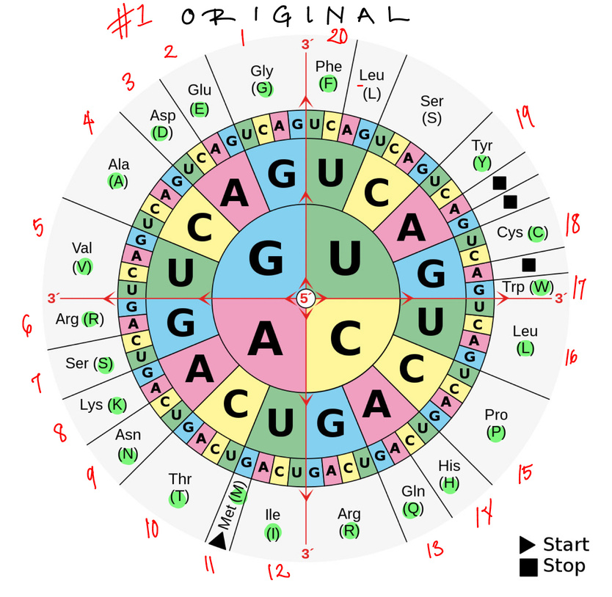
CODON WHEEL
  Traversing the outer rim of the wheel counter-clockwise
  Assigned a number from 1 to 20
  Skipping any duplicates.

Slide 7
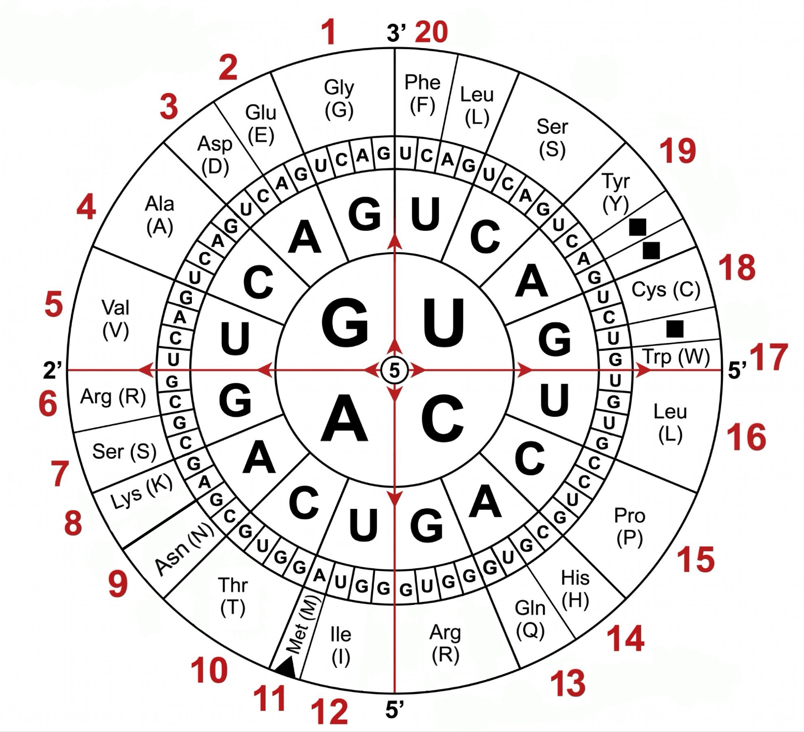
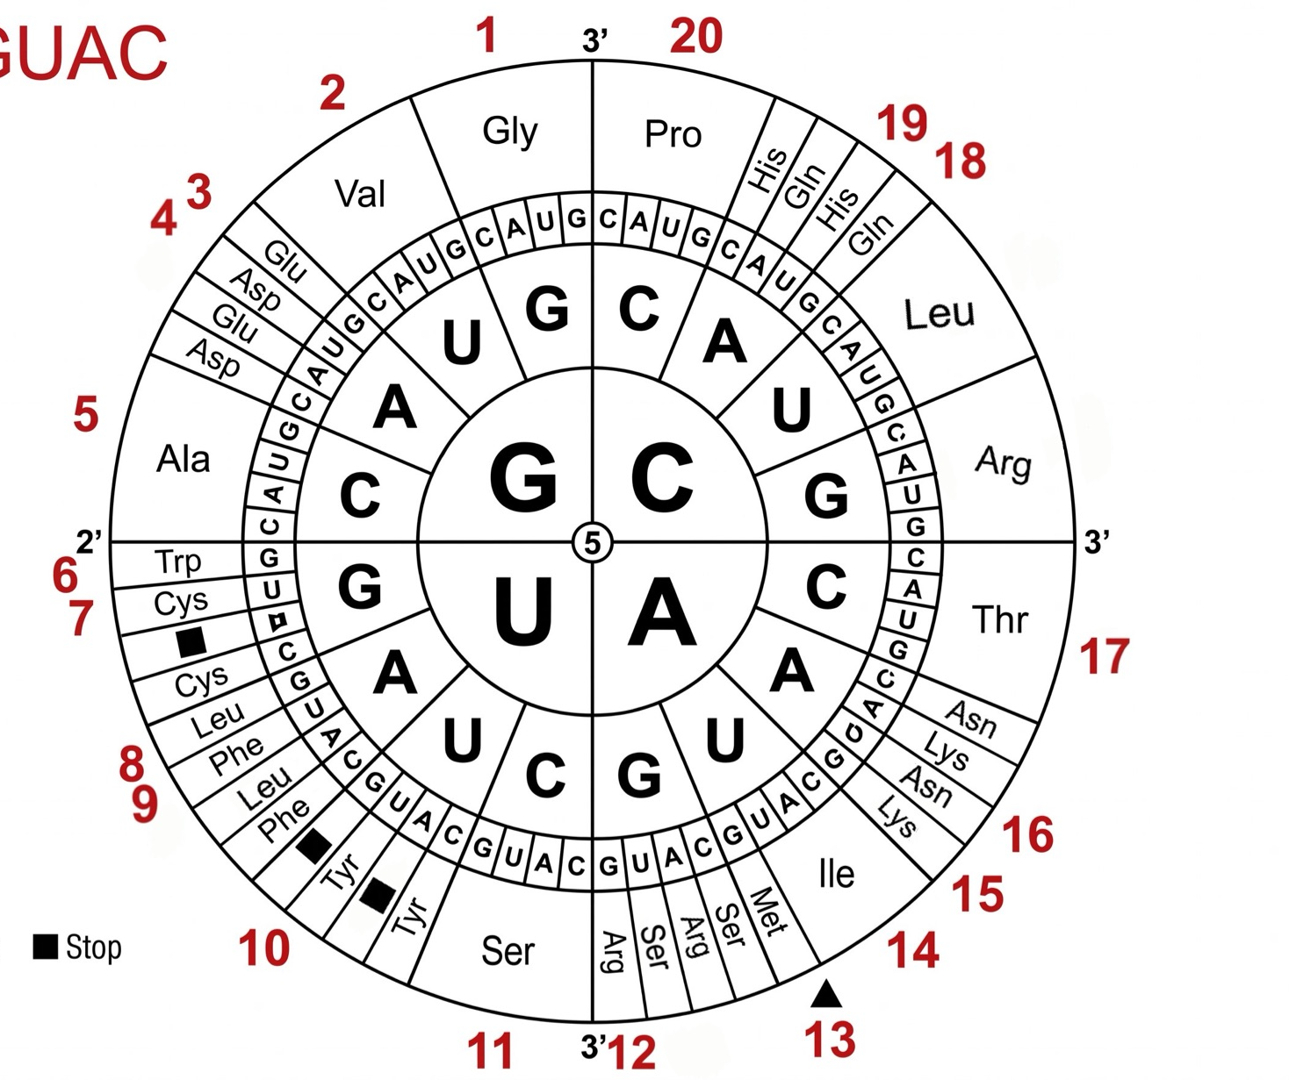
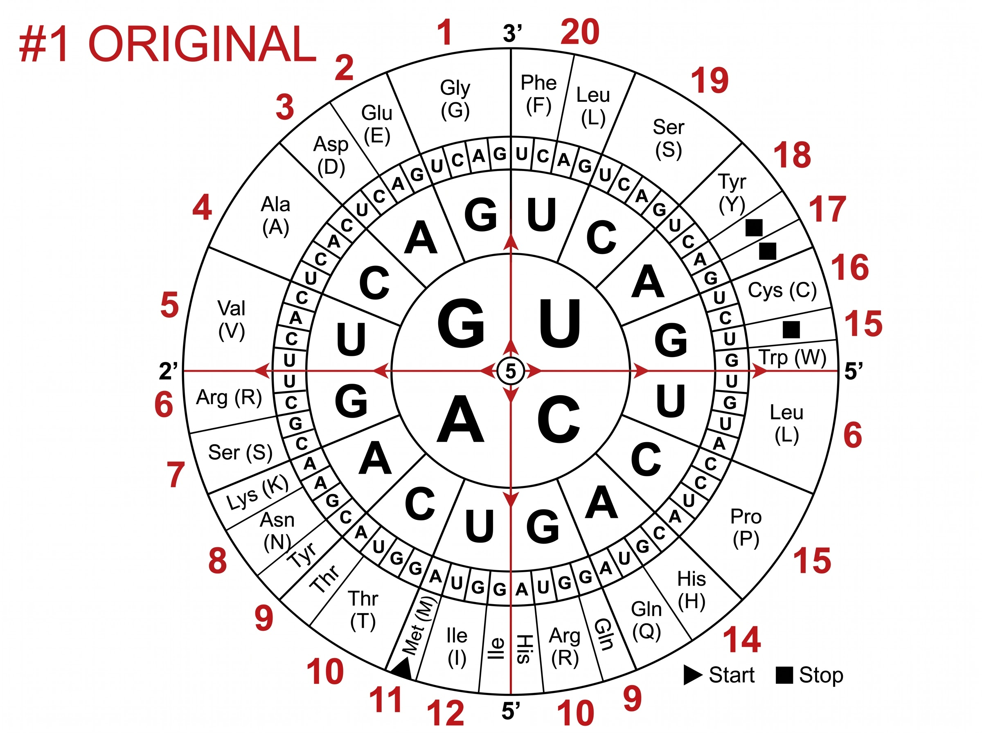
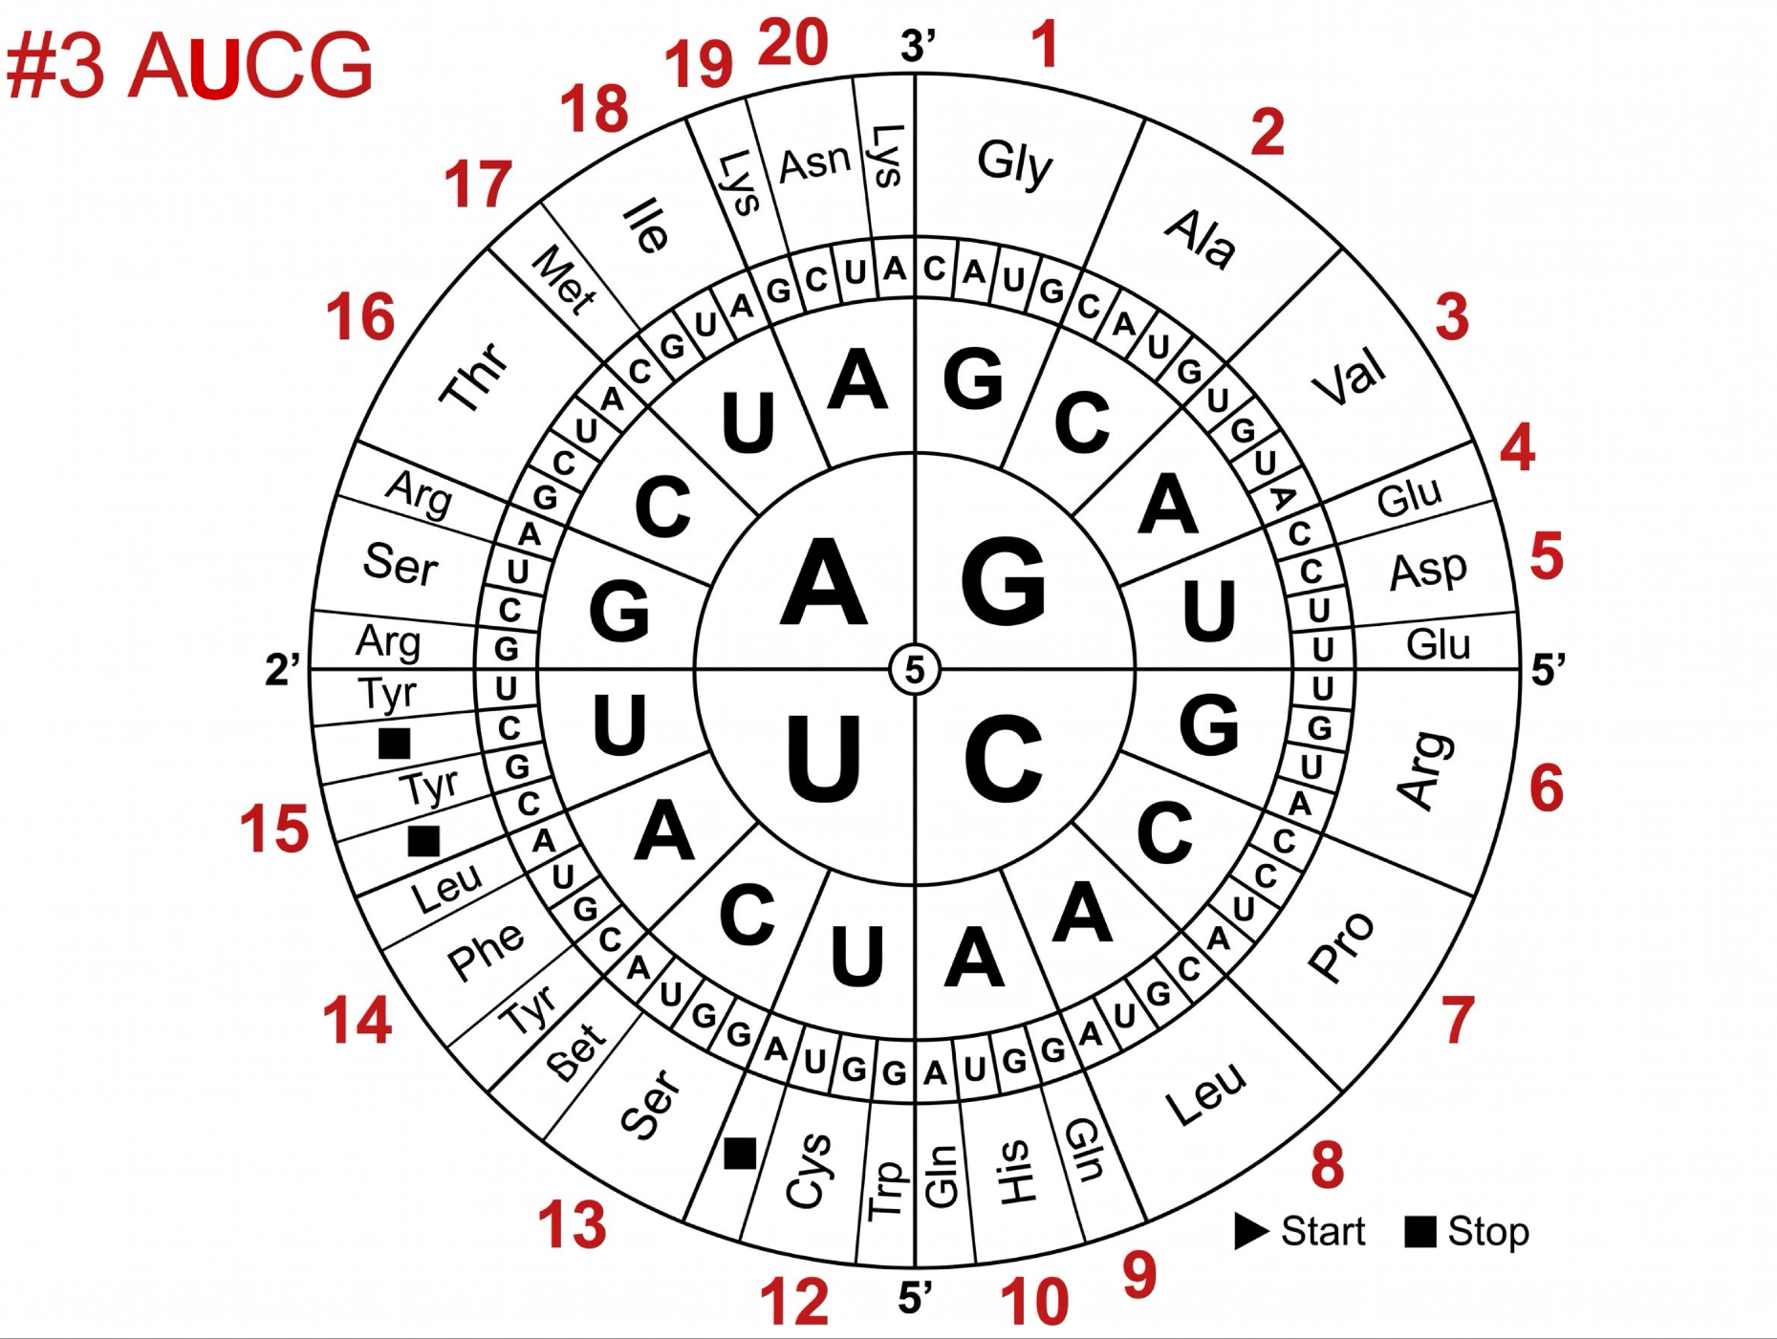
Permutations
  GACU / GUAC / AUCG
Wheel 1 - The original order
Wheel 2 - codon orientation GUAC
Wheel 3 - codon orientation AUCG
Notes:
All permutations of the GACU, we have weheels, but most of them are .. or reflectionsof one another, but htere are only three that are unique. We did all possible, and 1/3 of them ar e just a rotation or mirror image of the wheel. And there are two otehrs that are unique that are actually different. So we were looking carefully at wheel 2 and 3 because they may be better. Are there fewer duplcicates.

Slide 8
NUMERICAL ASSIGNMENT OF AMINO ACIDS
 | #1 Original | #2 GUAC | #3 AUCG
1 | Gly (G) | Gly (G) | Gly (G)
2 | Glu (E) | Val (V) | Ala (A)
3 | Asp (D) | Glu (E. ) | Val (V)
4 | Ala (A) | Asp (D) | Glu (E)
5 | Val (V) | Ala (A) | Asp (D)
6 | Arg (R) | Trp (W) | Arg (R)
7 | Ser (S) | Cys (C) | Pro (P)
8 | Lys (K) | Leu (L) | Leu (L)
9 | Asn (N) | Phe (F) | Gln (Q)
10 | Thr (T) | Tyr (Y) | His (H)
11 | Met (M) | Ser (S) | Trp (W)
12 | Ile (I) | Arg (R) | Cys (C)
13 | Gln (Q) | Met (M) | Ser (S)
14 | His (H) | Ile (I) | Phe (F)
15 | Pro (P) | Lys (K) | Tyr (Y)
16 | Leu (L) | Asn (N) | Thr (T)
17 | Trp (W) | Thr (T) | Met (M)
18 | Cys (C) | Gln (Q) | Ile (I)
19 | Tyr (Y) | His (H) | Lys (K)
20 | Phe (F) | Pro (P) | Asn (N)
Notes:
This is actually in a code for amino acids. The odering for. The code to represent the different amino acids by a number. Codin gand Decoding.

Slide 9
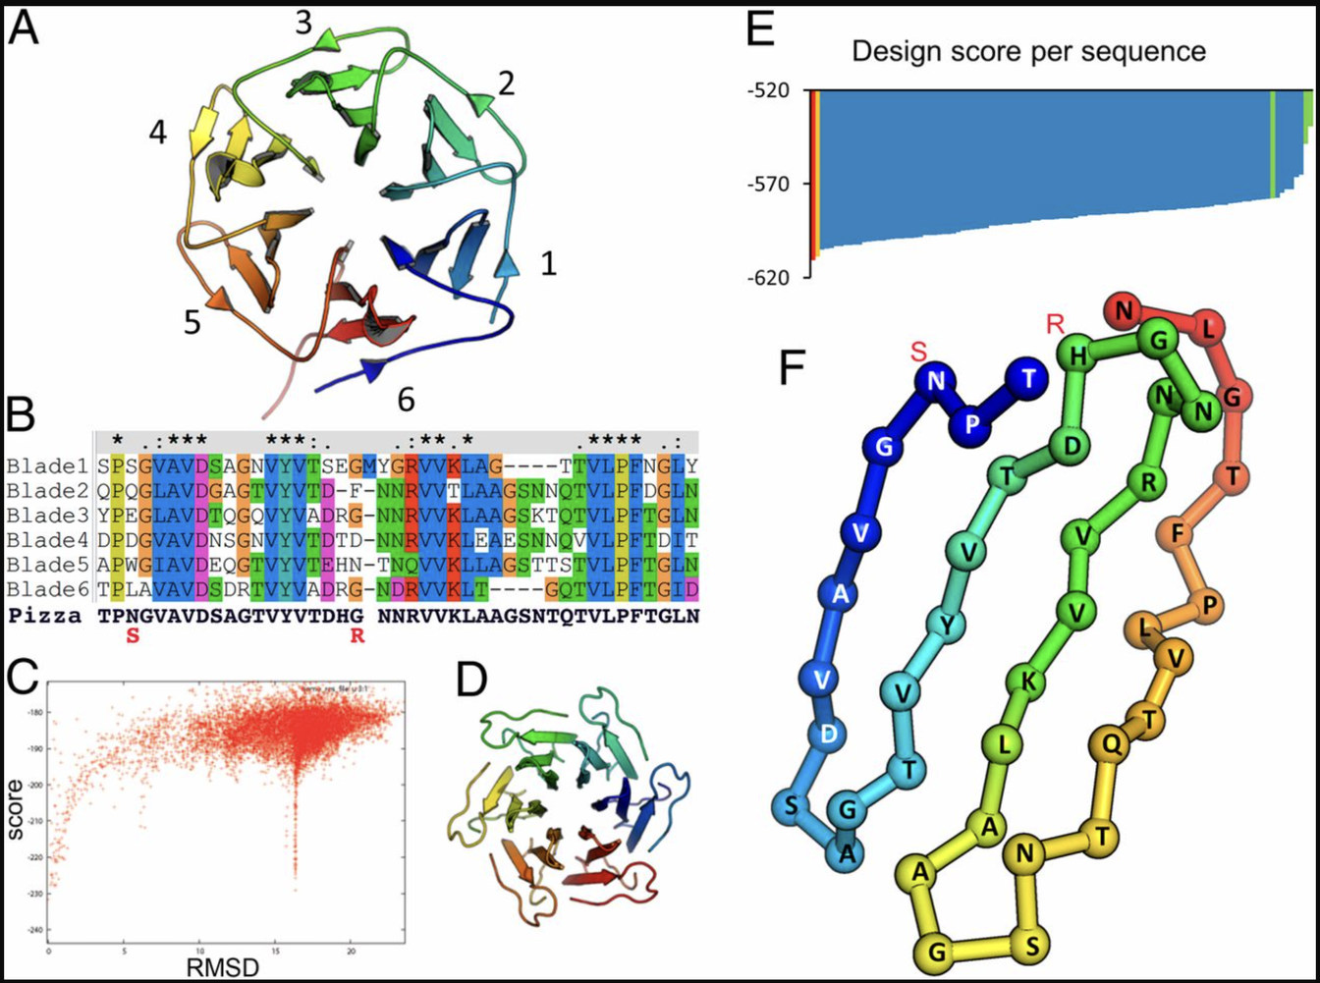
PIZZA6-SYW
84-amino-acid chain that perfectly repeats 3 times, but actually made of two nearly identical 42-amino-acid blocks (Block A and Block B) that only differ by a single amino acid at position 27
GSHM Block A Block B
SNTQTVLPFTGLNTPSGVAVDSAGTVWVTDHGNNRVVKLAAG
SNTQTVLPFTGLNTPSGVAVDSAGTVYVTDHGNNRVVKLAAG
SNTQTVLPFTGLNTPSGVAVDSAGTVWVTDHGNNRVVKLAAG
SNTQTVLPFTGLNTPSGVAVDSAGTVYVTDHGNNRVVKLAAG
SNTQTVLPFTGLNTPSGVAVDSAGTVWVTDHGNNRVVKLAAG
SNTQTVLPFTGLNTPSGVAVDSAGTVYVTDHGNNRVVKLAAG

Slide 10
NUMERICAL ASSIGNMENT OF AMINO ACIDS
Wheel 1 - The original order of the amino acid wheel
1, 7, 14,11,
7, 9, 10, 13, 10, 5, 16, 15, 20, 10, 1, 16, 9, 10, 15, 7, 1, 5, 4, 5, 3, 7, 4, 1, 10, 5, 17, 5, 10, 3, 14, 1, 9, 9, 6, 5, 5, 8, 16, 4, 4, 1,
7, 9, 10, 13, 10, 5, 16, 15, 20, 10, 1, 16, 9, 10, 15, 7, 1, 5, 4, 5, 3, 7, 4, 1, 10, 5, 19, 5, 10, 3, 14, 1, 9, 9, 6, 5, 5, 8, 16, 4, 4, 1,
7, 9, 10, 13, 10, 5, 16, 15, 20, 10, 1, 16, 9, 10, 15, 7, 1, 5, 4, 5, 3, 7, 4, 1, 10, 5, 17, 5, 10, 3, 14, 1, 9, 9, 6, 5, 5, 8, 16, 4, 4, 1,
7, 9, 10, 13, 10, 5, 16, 15, 20, 10, 1, 16, 9, 10, 15, 7, 1, 5, 4, 5, 3, 7, 4, 1, 10, 5, 19, 5, 10, 3, 14, 1, 9, 9, 6, 5, 5, 8, 16, 4, 4, 1,
7, 9, 10, 13, 10, 5, 16, 15, 20, 10, 1, 16, 9, 10, 15, 7, 1, 5, 4, 5, 3, 7, 4, 1, 10, 5, 17, 5, 10, 3, 14, 1, 9, 9, 6, 5, 5, 8, 16, 4, 4, 1,
7, 9, 10, 13, 10, 5, 16, 15, 20, 10, 1, 16, 9, 10, 15, 7, 1, 5, 4, 5, 3, 7, 4, 1, 10, 5, 19, 5, 10, 3, 14, 1, 9, 9, 6, 5, 5, 8, 16, 4, 4, 1
GSHM Block A Block B
SNTQTVLPFTGLNTPSGVAVDSAGTVWVTDHGNNRVVKLAAG
SNTQTVLPFTGLNTPSGVAVDSAGTVYVTDHGNNRVVKLAAG
SNTQTVLPFTGLNTPSGVAVDSAGTVWVTDHGNNRVVKLAAG
SNTQTVLPFTGLNTPSGVAVDSAGTVYVTDHGNNRVVKLAAG
SNTQTVLPFTGLNTPSGVAVDSAGTVWVTDHGNNRVVKLAAG
SNTQTVLPFTGLNTPSGVAVDSAGTVYVTDHGNNRVVKLAAG
Wheel 2 - codon orientation GUAC
1, 11, 19, 13,
11, 16, 17, 18, 17, 2, 8, 20, 9, 17, 1, 8, 16, 17, 20, 11, 1, 2, 5, 2, 4, 11, 5, 1, 17, 2, 6,2, 17, 4, 19, 1, 16, 16, 12, 2, 2, 15, 8, 5, 5, 1,
11, 16, 17, 18, 17, 2, 8, 20, 9, 17, 1, 8, 16, 17, 20, 11, 1, 2, 5, 2, 4, 11, 5, 1, 17, 2, 10, 2, 17, 4, 19, 1, 16, 16, 12, 2, 2, 15, 8, 5, 5, 1,
11, 16, 17, 18, 17, 2, 8, 20, 9, 17, 1, 8, 16, 17, 20, 11, 1, 2, 5, 2, 4, 11, 5, 1, 17, 2, 6, 2, 17, 4, 19, 1, 16, 16, 12, 2, 2, 15, 8, 5, 5, 1,
11, 16, 17, 18, 17, 2, 8, 20, 9, 17, 1, 8, 16, 17, 20, 11, 1, 2, 5, 2, 4, 11, 5, 1, 17, 2, 10, 2, 17, 4, 19, 1, 16, 16, 12, 2, 2, 15, 8, 5, 5, 1,
11, 16, 17, 18, 17, 2, 8, 20, 9, 17, 1, 8, 16, 17, 20, 11, 1, 2, 5, 2, 4, 11, 5, 1, 17, 2, 6, 2, 17, 4, 19, 1, 16, 16, 12, 2, 2, 15, 8, 5, 5, 1,
11, 16, 17, 18, 17, 2, 8, 20, 9, 17, 1, 8, 16, 17, 20, 11, 1, 2, 5, 2, 4, 11, 5, 1, 17, 2, 10, 2, 17, 4, 19, 1, 16, 16, 12, 2, 2, 15, 8, 5, 5, 1
Wheel 3 - Alternative reordered sequences based on GCUA
1, 13, 10, 17,
13, 20, 16, 9, 16, 3, 8, 7, 14, 16, 1, 8, 20, 16, 7, 13, 1, 3, 2, 3, 5, 13, 2, 1, 16, 3,11, 3, 16, 5, 10, 1, 20, 20, 6, 3, 3, 19, 8, 2, 2, 1,
13, 20, 16, 9, 16, 3, 8, 7, 14, 16, 1, 8, 20, 16, 7, 13, 1, 3, 2, 3, 5, 13, 2, 1, 16, 3, 15, 3, 16, 5, 10, 1, 20, 20, 6, 3, 3, 19, 8, 2, 2, 1,
13, 20, 16, 9, 16, 3, 8, 7, 14, 16, 1, 8, 20, 16, 7, 13, 1, 3, 2, 3, 5, 13, 2, 1, 16, 3, 11, 3, 16, 5, 10, 1, 20, 20, 6, 3, 3, 19, 8, 2, 2, 1,
13, 20, 16, 9, 16, 3, 8, 7, 14, 16, 1, 8, 20, 16, 7, 13, 1, 3, 2, 3, 5, 13, 2, 1, 16, 3, 15, 3, 16, 5, 10, 1, 20, 20, 6, 3, 3, 19, 8, 2, 2, 1,
13, 20, 16, 9, 16, 3, 8, 7, 14, 16, 1, 8, 20, 16, 7, 13, 1, 3, 2, 3, 5, 13, 2, 1, 16, 3, 11, 3, 16, 5, 10, 1, 20, 20, 6, 3, 3, 19, 8, 2, 2, 1,
13, 20, 16, 9, 16, 3, 8, 7, 14, 16, 1, 8, 20, 16, 7, 13, 1, 3, 2, 3, 5, 13, 2, 1, 16, 3, 15, 3, 16, 5, 10, 1, 20, 20, 6, 3, 3, 19, 8, 2, 2, 1
Notes:
Each one has the near duplicatio just as your Y is the only difference betwen wings and there is that single number that changes. In wheel 2 6 changes to 10 back and forth.
The first four are not getting repeated but well fouc on the repeating part.

Slide 11
Wheel 1 - The original order of the amino acid wheel
$$\left\{\overset{3}{€}\left[\overset{1}{\underset{i⊨0}{€}}\left[7,9,10,13,10,5,16,15,20,10,1,16,9,10,15,7,1,5,4,5,3,7,4,1,10,5,17+2⁢i,5,10,3,14,1,\overset{2}{€}\left[9\right],6,\overset{2}{€}\left[5\right],8,16,\overset{2}{€}\left[4\right],1\right]\right]\right\}$$
Wheel 2 - codon orientation GUAC
$$\left\{\overset{3}{€}\left[\begin{aligned}\overset{1}{\underset{i⊨0}{€}}11,16,17,18,17,2,8,20,9,17,1,8,16,17,20,11,1,2,5,2,4,11,5,1,17,2,6+4i,2,17,4,19,1,\overset{2}{€}\left[16\right],12,\overset{2}{€}\left[2\right],15,8,\overset{2}{€}\left[5\right],1 \\ \end{aligned}\right]\right\}$$
Wheel 3 - Alternative reordered GCUA
$$\left\{\overset{3}{€}\left[\overset{1}{\underset{i⊨0}{€}}\left[13,20,16,9,16,3,8,7,14,16,1,8,20,16,7,13,1,3,2,3,5,13,2,1,16,3,11+4⁢i,3,16,5,10,1,\overset{2}{€}\left[20\right],6,\overset{2}{€}\left[3\right],19,8,\overset{2}{€}\left[2\right],1\right]\right]\right\}$$
Notes:
Fairly equal or comporable equations.
The tiny change goig through the equation and every icat. We did some little internal summaries. the first string of numbers we did not find a clear summary, but we do have a summary.
Show the notation of three exact copies, where Ii take a differnet values.

Slide 12

6Y7P_A: TAKO8
Model 1 - The original order of the amino acid wheel
1, 7, 14, 11, 1,
13, 7, 16, 6, 10, 16, 13, 1, 14, 13, 7, 4, 5, 10, 7, 16, 13, 20, 9, 3, 9, 12, 5, 5, 7, 1, 7, 3, 3, 7, 10, 5, 8, 5, 17, 3, 12, 8, 10, 1,
13, 7, 16, 6, 10, 16, 13, 1, 14, 13, 7, 4, 5, 10, 7, 16, 13, 20, 9, 3, 9, 12, 5, 5, 7, 1, 7, 3, 3, 7, 10, 5, 8, 5, 17, 3, 12, 8, 10, 1,
13, 7, 16, 6, 10, 16, 13, 1, 14, 13, 7, 4, 5, 10, 7, 16, 13, 20, 9, 3, 9, 12, 5, 5, 7, 1, 7, 3, 3, 7, 10, 5, 8, 5, 17, 3, 12, 8, 10, 1,
13, 7, 16, 6, 10, 16, 13, 1, 14, 13, 7, 4, 5, 10, 7, 16, 13, 20, 9, 3, 9, 12, 5, 5, 7, 1, 7, 3, 3, 7, 10, 5, 8, 5, 17, 3, 12, 8, 10, 1,
13, 7, 16, 6, 10, 16, 13, 1, 14, 13, 7, 4, 5, 10, 7, 16, 13, 20, 9, 3, 9, 12, 5, 5, 7, 1, 7, 3, 3, 7, 10, 5, 8, 5, 17, 3, 12, 8, 10, 1,
13, 7, 16, 6, 10, 16, 13, 1, 14, 13, 7, 4, 5, 10, 7, 16, 13, 20, 9, 3, 9, 12, 5, 5, 7, 1, 7, 3, 3, 7, 10, 5, 8, 5, 17, 3, 12, 8, 10, 1,
13, 7, 16, 6, 10, 16, 13, 1, 14, 13, 7, 4, 5, 10, 7, 16, 13, 20, 9, 3, 9, 12, 5, 5, 7, 1, 7, 3, 3, 7, 10, 5, 8, 5, 17, 3, 12, 8, 10, 1,
13, 7, 16, 6, 10, 16, 13, 1, 14, 13, 7, 4, 5, 10, 7, 16, 13, 20, 9, 3, 9, 12, 5, 5, 7, 1, 7, 3, 3, 7, 10, 5, 8, 5, 17, 3, 12, 8, 1, 7
Model 2 - codon orientation GUAC
1, 11, 19, 13, 1,
18, 11, 8, 12, 17, 8, 18, 1, 19, 18, 11, 5, 2, 17, 11, 8, 18, 9, 16, 4, 16, 14, 2, 2, 11, 1, 11, 4, 4, 11, 17, 2, 15, 2, 6, 4, 14, 15, 17, 1,
18, 11, 8, 12, 17, 8, 18, 1, 19, 18, 11, 5, 2, 17, 11, 8, 18, 9, 16, 4, 16, 14, 2, 2, 11, 1, 11, 4, 4, 11, 17, 2, 15, 2, 6, 4, 14, 15, 17, 1,
18, 11, 8, 12, 17, 8, 18, 1, 19, 18, 11, 5, 2, 17, 11, 8, 18, 9, 16, 4, 16, 14, 2, 2, 11, 1, 11, 4, 4, 11, 17, 2, 15, 2, 6, 4, 14, 15, 17, 1,
18, 11, 8, 12, 17, 8, 18, 1, 19, 18, 11, 5, 2, 17, 11, 8, 18, 9, 16, 4, 16, 14, 2, 2, 11, 1, 11, 4, 4, 11, 17, 2, 15, 2, 6, 4, 14, 15, 17, 1,
18, 11, 8, 12, 17, 8, 18, 1, 19, 18, 11, 5, 2, 17, 11, 8, 18, 9, 16, 4, 16, 14, 2, 2, 11, 1, 11, 4, 4, 11, 17, 2, 15, 2, 6, 4, 14, 15, 17, 1,
18, 11, 8, 12, 17, 8, 18, 1, 19, 18, 11, 5, 2, 17, 11, 8, 18, 9, 16, 4, 16, 14, 2, 2, 11, 1, 11, 4, 4, 11, 17, 2, 15, 2, 6, 4, 14, 15, 17, 1,
18, 11, 8, 12, 17, 8, 18, 1, 19, 18, 11, 5, 2, 17, 11, 8, 18, 9, 16, 4, 16, 14, 2, 2, 11, 1, 11, 4, 4, 11, 17, 2, 15, 2, 6, 4, 14, 15, 17, 1,
18, 11, 8, 12, 17, 8, 18, 1, 19, 18, 11, 5, 2, 17, 11, 8, 18, 9, 16, 4, 16, 14, 2, 2, 11, 1, 11, 4, 4, 11, 17, 2, 15, 2, 6, 4, 14, 15, 1, 11
GSHMG
QSLRTLQGHQSAVTSLQFNDNIVVSGSDDSTVKVWDIKTG
QSLRTLQGHQSAVTSLQFNDNIVVSGSDDSTVKVWDIKTG
QSLRTLQGHQSAVTSLQFNDNIVVSGSDDSTVKVWDIKTG
QSLRTLQGHQSAVTSLQFNDNIVVSGSDDSTVKVWDIKTG
QSLRTLQGHQSAVTSLQFNDNIVVSGSDDSTVKVWDIKTG
QSLRTLQGHQSAVTSLQFNDNIVVSGSDDSTVKVWDIKTG
QSLRTLQGHQSAVTSLQFNDNIVVSGSDDSTVKVWDIKTG
QSLRTLQGHQSAVTSLQFNDNIVVSGSDDSTVKVWDIKGS
Model 3 - Alternative reordered sequences based on GCUA
11, 13, 10, 17, 1,
9, 13, 8, 6, 16, 8, 9, 1, 10, 9, 13, 2, 3, 16, 13, 8, 9, 14, 20, 5, 20, 18, 3, 3, 13, 1, 13, 5, 5, 13, 16, 3, 19, 3, 11, 5, 18, 19, 16, 1,
9, 13, 8, 6, 16, 8, 9, 1, 10, 9, 13, 2, 3, 16, 13, 8, 9, 14, 20, 5, 20, 18, 3, 3, 13, 1, 13, 5, 5, 13, 16, 3, 19, 3, 11, 5, 18, 19, 16, 1,
9, 13, 8, 6, 16, 8, 9, 1, 10, 9, 13, 2, 3, 16, 13, 8, 9, 14, 20, 5, 20, 18, 3, 3, 13, 1, 13, 5, 5, 13, 16, 3, 19, 3, 11, 5, 18, 19, 16, 1,
9, 13, 8, 6, 16, 8, 9, 1, 10, 9, 13, 2, 3, 16, 13, 8, 9, 14, 20, 5, 20, 18, 3, 3, 13, 1, 13, 5, 5, 13, 16, 3, 19, 3, 11, 5, 18, 19, 16, 1,
9, 13, 8, 6, 16, 8, 9, 1, 10, 9, 13, 2, 3, 16, 13, 8, 9, 14, 20, 5, 20, 18, 3, 3, 13, 1, 13, 5, 5, 13, 16, 3, 19, 3, 11, 5, 18, 19, 16, 1,
9, 13, 8, 6, 16, 8, 9, 1, 10, 9, 13, 2, 3, 16, 13, 8, 9, 14, 20, 5, 20, 18, 3, 3, 13, 1, 13, 5, 5, 13, 16, 3, 19, 3, 11, 5, 18, 19, 16, 1,
9, 13, 8, 6, 16, 8, 9, 1, 10, 9, 13, 2, 3, 16, 13, 8, 9, 14, 20, 5, 20, 18, 3, 3, 13, 1, 13, 5, 5, 13, 16, 3, 19, 3, 11, 5, 18, 19, 16, 1,
9, 13, 8, 6, 16, 8, 9, 1, 10, 9, 13, 2, 3, 16, 13, 8, 9, 14, 20, 5, 20, 18, 3, 3, 13, 1, 13, 5, 5, 13, 16, 3, 19, 3, 11, 5, 18, 19, 1, 13
Notes:
Counting the

Slide 13
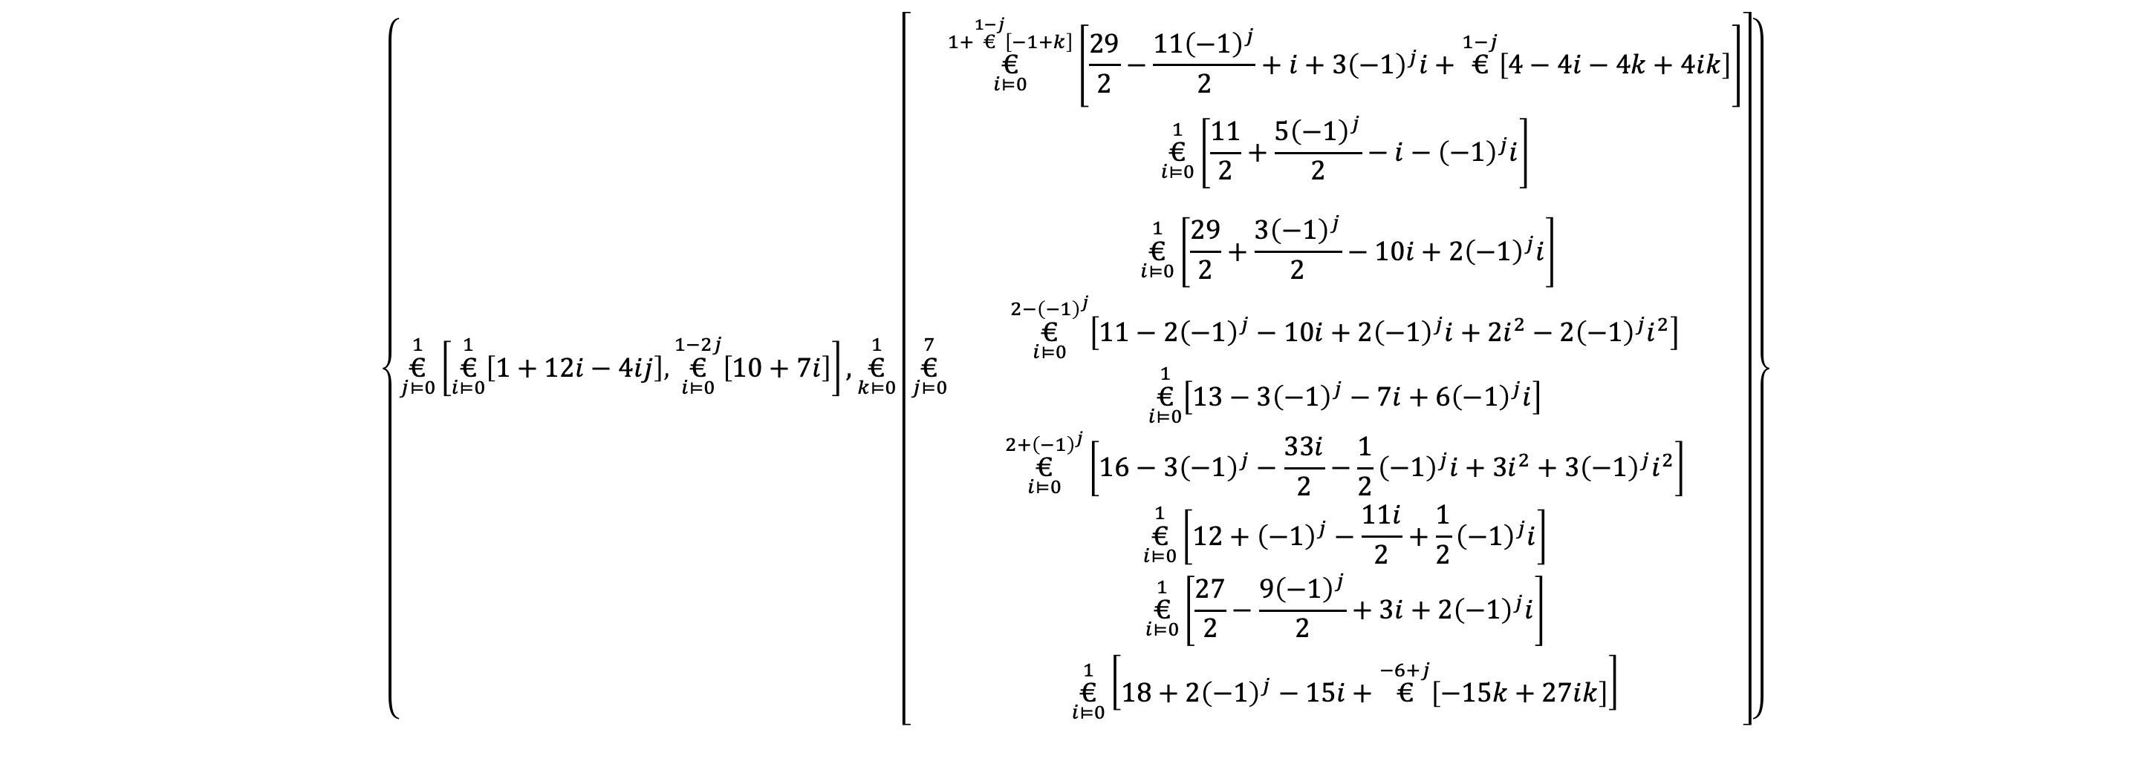
Wheel 2 - codon orientation GUAC
$$\left\{\overset{7}{\underset{i⊨0}{€}}\left[18,11,8,12,17,8,18,1,19,18,11,5,2,17,11,8,18,9,16,4,16,14,\overset{2}{€}\left[2\right],11,1,11,\overset{2}{€}\left[4\right],11,17,2,15,2,6,4,14,15,17−0​⧺​\overset{i−6}{€}\left[16\right],1​⧺\overset{i−6}{€}\left[1\right]\right]\right\}$$
Wheel 2 –using Kronecker Delta ($δ_{7,i}$)
$$\left\{\overset{7}{\underset{i⊨0}{€}}\left[18,11,8,12,17,8,18,1,19,18,11,5,2,17,11,8,18,9,16,4,16,14,\overset{2}{€}\left[2\right],11,1,11,\overset{2}{€}\left[4\right],11,17,2,15,2,6,4,14,15,17−16δ_{7,i},1+10δ_{7,i}\right]\right\}$$
Wheel 3 – Derek’s Algorithm
$$\left\{\overset{1}{\underset{j⊨0}{€}}\left[\overset{1}{\underset{i⊨0}{€}}\left[1+12⁢i−4⁢i⁢j\right] , \overset{1−2⁢j}{\underset{i⊨0}{€}}\left[10+7⁢i\right]\right],\overset{1}{\underset{k⊨0}{€}}\left[\overset{7}{\underset{j⊨0}{€}}\begin{aligned}\overset{1+\overset{1−j}{€}\left[−1+k\right]}{\underset{i⊨0}{€}}\left[\frac{29}{2}−\frac{11⁢{\left(−1\right)}^{j}}{2}+i+3⁢{\left(−1\right)}^{j}⁢i+\overset{1−j}{€}\left[4−4⁢i−4⁢k+4⁢i⁢k\right]\right] \\ \overset{1}{\underset{i⊨0}{€}}\left[\frac{11}{2}+\frac{5⁢{\left(−1\right)}^{j}}{2}−i−{\left(−1\right)}^{j}⁢i\right] \\ \\ \begin{aligned} \\ \overset{1}{\underset{i⊨0}{€}}\left[\frac{29}{2}+\frac{3⁢{\left(−1\right)}^{j}}{2}−10⁢i+2⁢{\left(−1\right)}^{j}⁢i\right]\end{aligned} \\ \overset{2−{\left(−1\right)}^{j}}{\underset{i⊨0}{€}}\left[11−2⁢{\left(−1\right)}^{j}−10⁢i+2⁢{\left(−1\right)}^{j}⁢i+2⁢i^{2}−2⁢{\left(−1\right)}^{j}⁢i^{2}\right] \\ \overset{1}{\underset{i⊨0}{€}}\left[13−3⁢{\left(−1\right)}^{j}−7⁢i+6⁢{\left(−1\right)}^{j}⁢i\right] \\ \overset{2+{\left(−1\right)}^{j}}{\underset{i⊨0}{€}}\left[16−3⁢{\left(−1\right)}^{j}−\frac{33⁢i}{2}−\frac{1}{2}⁢{\left(−1\right)}^{j}⁢i+3⁢i^{2}+3⁢{\left(−1\right)}^{j}⁢i^{2}\right] \\ \overset{1}{\underset{i⊨0}{€}}\left[12+{\left(−1\right)}^{j}−\frac{11⁢i}{2}+\frac{1}{2}⁢{\left(−1\right)}^{j}⁢i\right] \\ \overset{1}{\underset{i⊨0}{€}}\left[\frac{27}{2}−\frac{9⁢{\left(−1\right)}^{j}}{2}+3⁢i+2⁢{\left(−1\right)}^{j}⁢i\right] \\ \overset{1}{\underset{i⊨0}{€}}\left[18+2⁢{\left(−1\right)}^{j}−15⁢i+\overset{−6+j}{€}\left[−15⁢k+27⁢i⁢k\right]\right]\end{aligned}\right]\right\}$$
Notes:
Kronecker Delta works when Its only 1 when i=j, for all other cases it is equal to zero
Both the first summary and the second summary are almost the same, except when you come to the end where you need different number. We have 17,1 and last time we need 1, 11. We can get that through concatenation, and we do not use, 7 whihc gets added on or joined on whatever came before. Pure icat notation, and using Kronecher Delta.
icats explain everything, but its kind of complicated. We don't really see if it helps us understand a pattern. But there is more than one way to explain this sequences of numbers usin gICAT Notation.

Slide 14
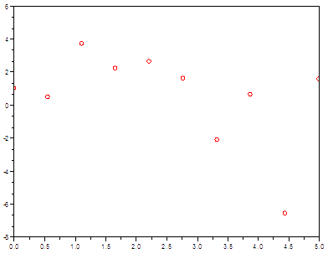
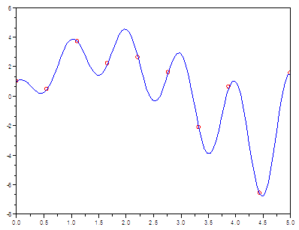
Too many adjustable parameters
Can match any data with an infinite number of functions!
Nothing fundamental learned
Notes:
There is nothing fundamental that can be learned here. \ Data points on a graph can be fit by an infinite number of functions – the particular choice you make is meaningless.
http://www.matrixlab-examples.com/curve-fit.html
We can match data when there is a formula whatever data you need. But does it

Slide 16
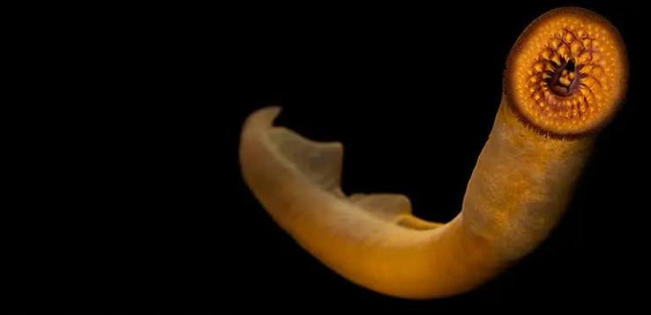

Slide 17
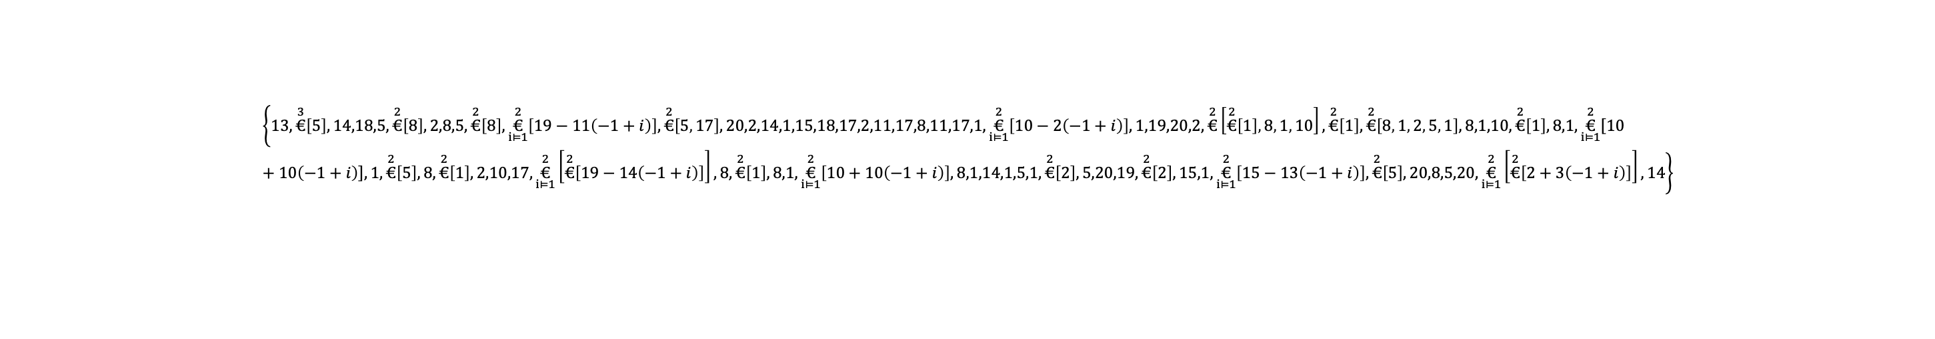
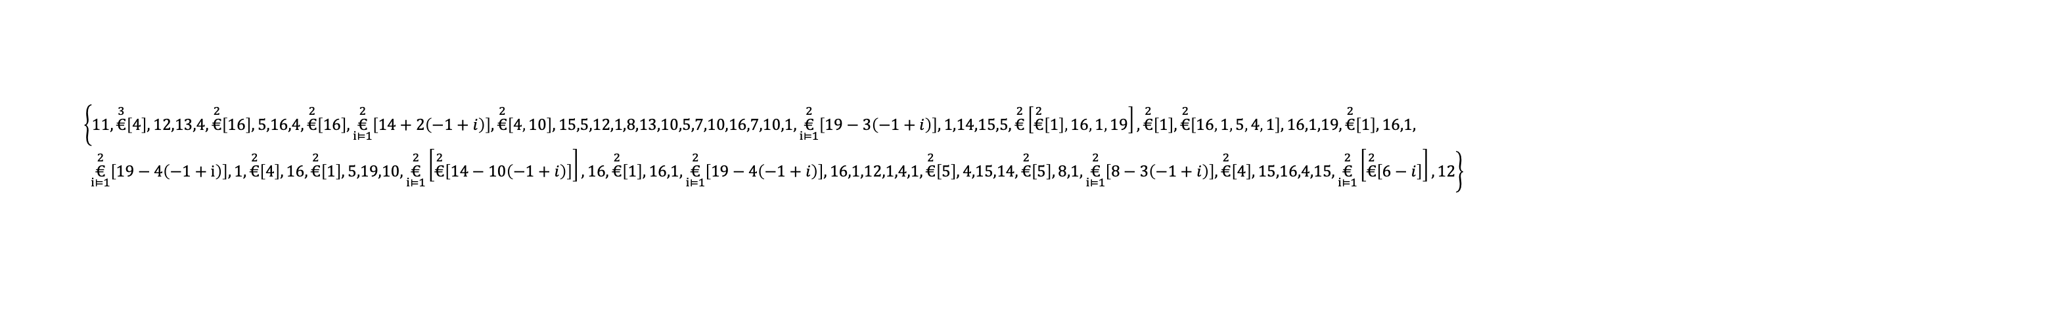
Lamprin L-0.8-10
Q9YGD0 · Q9YGD0_PETMA
This protein is associated with the sea lamprey!
Repetitive, glycine-rich amino acid motifs &119 amino acids
MAAAIQALLVLALLHLATATPVIGKQTVSTLSTGYLGHPVGGLGYGGLGYGGLGVAGLGVAG
LGYGGLGYPGAALGGVYTHHAALGGLGYPLGIGAGVVAPHVVKGKVAAPLAPVVAAI
Wheel 1 - The original order of the amino acid wheel
$$\left\{11,\overset{3}{€}\left[4\right],12,13,4,\overset{2}{€}\left[16\right],5,16,4,\overset{2}{€}\left[16\right],\overset{2}{\underset{i⊨1}{€}}\left[14+2⁢\left(−1+i\right)\right],\overset{2}{€}\left[4 , 10\right],15,5,12,1,8,13,10,5,7,10,16,7,10,1,\overset{2}{\underset{i⊨1}{€}}\left[19−3⁢\left(−1+i\right)\right],1,14,15,5,\overset{2}{€}\left[\overset{2}{€}\left[1\right] , 16 , 1 , 19\right],\overset{2}{€}\left[1\right],\overset{2}{€}\left[16 , 1 , 5 , 4 , 1\right],16,1,19,\overset{2}{€}\left[1\right],16,1, \overset{2}{\underset{i⊨1}{€}}\left[19−4⁢\left(−1+i\right)\right],1,\overset{2}{€}\left[4\right],16,\overset{2}{€}\left[1\right],5,19,10,\overset{2}{\underset{i⊨1}{€}}\left[\overset{2}{€}\left[14−10⁢\left(−1+i\right)\right]\right],16,\overset{2}{€}\left[1\right],16,1,\overset{2}{\underset{i⊨1}{€}}\left[19−4⁢\left(−1+i\right)\right],16,1,12,1,4,1,\overset{2}{€}\left[5\right],4,15,14,\overset{2}{€}\left[5\right],8,1,\overset{2}{\underset{i⊨1}{€}}\left[8−3⁢\left(−1+i\right)\right],\overset{2}{€}\left[4\right],15,16,4,15,\overset{2}{\underset{i⊨1}{€}}\left[\overset{2}{€}\left[6−i\right]\right],12\right\}$$
Wheel 2 - codon orientation GUAC
$$\left\{13,\overset{3}{€}\left[5\right],14,18,5,\overset{2}{€}\left[8\right],2,8,5,\overset{2}{€}\left[8\right],\overset{2}{\underset{i⊨1}{€}}\left[19−11⁢\left(−1+i\right)\right],\overset{2}{€}\left[5 , 17\right],20,2,14,1,15,18,17,2,11,17,8,11,17,1,\overset{2}{\underset{i⊨1}{€}}\left[10−2⁢\left(−1+i\right)\right],1,19,20,2,\overset{2}{€}\left[\overset{2}{€}\left[1\right] , 8 , 1 , 10\right],\overset{2}{€}\left[1\right],\overset{2}{€}\left[8 , 1 , 2 , 5 , 1\right],8,1,10,\overset{2}{€}\left[1\right],8,1,\overset{2}{\underset{i⊨1}{€}}\left[10+10⁢\left(−1+i\right)\right],1,\overset{2}{€}\left[5\right],8,\overset{2}{€}\left[1\right],2,10,17,\overset{2}{\underset{i⊨1}{€}}\left[\overset{2}{€}\left[19−14⁢\left(−1+i\right)\right]\right],8,\overset{2}{€}\left[1\right],8,1,\overset{2}{\underset{i⊨1}{€}}\left[10+10⁢\left(−1+i\right)\right],8,1,14,1,5,1,\overset{2}{€}\left[2\right],5,20,19,\overset{2}{€}\left[2\right],15,1,\overset{2}{\underset{i⊨1}{€}}\left[15−13⁢\left(−1+i\right)\right],\overset{2}{€}\left[5\right],20,8,5,20,\overset{2}{\underset{i⊨1}{€}}\left[\overset{2}{€}\left[2+3⁢\left(−1+i\right)\right]\right],14\right\}$$

Slide 18
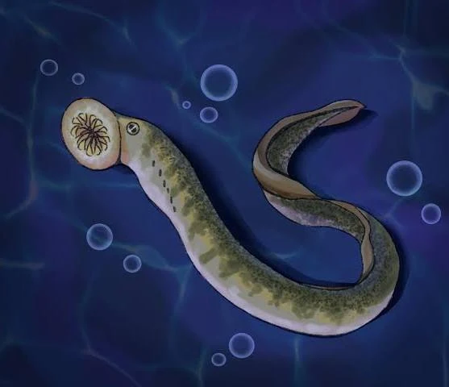
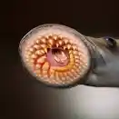
POSSIBILITES ARE ENDLESS!
ANY QUESTIONS?

